Slide 1
Derivative of Logarithmic Functions

Slide 2
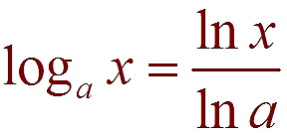
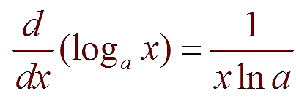
3- Derivative of Logarithm Function
a logarithmic function with base a in terms of the natural logarithmic function:
Since ln a is a constant, we can differentiate as follows:
example:

Slide 3
IMPORTANT and UNUSUAL: If you have a daunting task to find derivative in the case of a function raised to the function$\left(x^{x}, x^{\sin{x}} …\text{,}\right)$, or a crazy product, quotient, chain problem you do a simple trick:
FIRST find logarithm $,ln,$ so you’ll have sum instead of product, and product instead of exponent. Life will be much, much easier.
STEPS IN LOGARITHMIC DIFFERENTIATION
Take natural logarithms of both sides of an equation y = f(x) and use the Laws of Logarithms to simplify.
Differentiate implicitly with respect to x.
Solve the resulting equation for y’.

Slide 4
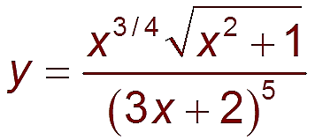
example:
Differentiate:
Since we have an explicit expression for y, we can substitute and write
If we hadn’t used logarithmic differentiation the resulting calculation would have been horrendous.

Slide 5
example:
$$y=x^{\sin{x}} y^{′}=?$$
$$\ln{y=}(\sin{x)\ln{x}} ⇒ \frac{1}{y} y^{′}=(\cos{x)\ln{x+ \frac{\sin{x}}{x}}}$$
$$y^{′}=(ln{x)x^{\sin{x}}\cos{x}+(\sin{x) }x^{\sin{x−1}}}$$
Try: $y={(\sin{x)}}^{x}$

